Slide 1
Lecture 2 – Multilevel Security
Security
Computer Science Tripos part 2
Ross Anderson

Slide 2
Context of Multilevel Security
Hierarchy: Top Secret, Secret, Confidential, …
Information mustn’t leak from High down to Low
Enforcement must be independent of user actions!
Perpetual problem: careless staff
1970s worry: operating system insecurity
1990s worry: virus at Low copies itself to High and starts signalling down (e.g. covert channel)

Slide 3
Context of Multilevel Security (2)
Nowadays: see our paper ‘The Snooping Dragon’
September 2008: Dalai Lama’s office realised there had been a security failure
Initial break: targeted email with bad pdf
Then: took over the mail server and spread it
About 35 or their 50 PCs were infected
Fix (Dharamsala): take ‘Secret’ stuff offline
Fix (UKUSA agencies): use MLS mail guards and firewalls to prevent ‘Secret’ stuff getting out

Slide 4
Formalising the Policy
Bell-LaPadula (1973):
  simple security policy: no read up
  *-policy: no write down
With these, one can prove that a system which starts in a secure state will remain in one
Ideal: minimise the Trusted Computing Base (set of hardware, software and procedures that can break the security policy) so it’s verifiable
1970s idea: use a reference monitor

Slide 5
Objections to BLP
Some processes, such as memory management, need to read and write at all levels
Fix: put them in the trusted computing base
Consequence: once you put in all the stuff a real system needs (backup, recovery, comms, …) the TCB is no longer small enough to be easily verifiable

Slide 6
Objections to BLP (2)
John MacLean’s “System Z”: as BLP but lets users request temporary declassification of any file
Fix: add tranquility principles
  Strong tranquility: labels never change
  Weak tranquility: they don’t change in such a way as to break the security policy
Usual choice: weak tranquility using the “high watermark principle” – a process acquires the highest label of any resource it’s touched
Problem: have to rewrite apps (e.g. license server)

Slide 7
Covert Channels
In 1973 Butler Lampson warned BLP might be impractical because of covert channels: “neither designed not intended to carry information at all”
A Trojan at High signals to a buddy at Low by modulating a shared system resource
  Fills the disk (storage channel)
  Loads the CPU (timing channel)
Capacity depends on bandwidth and S/N. So: cut the bandwidth or increase the noise
But it’s really hard to get below 1bps or so…

Slide 8
Objections to BLP (3)
High can’t acknowledge receipt from Low
This blind write-up is often inconvenient: information vanishes into a black hole
Option 1: accept this and engineer for it (Morris theory) – CIA usenet feed
Option 2: allow acks, but be aware that they might be used by High to signal to Low
Use some combination of software trust and covert channel elimination (more later …)

Slide 9
Variants on Bell-LaPadula
Noninterference: no input by High can affect what Low can see. So whatever trace there is for High input X, there’s a trace with High input Ø that looks the same to Low (Goguen and Messeguer 1982)
Nondeducibility: weakens this so that Low is allowed to see High data, just not to understand it – e.g. a LAN where Low can see encrypted High packets going past (Sutherland 1986)

Slide 10
Variants on Bell-LaPadula (2)
Biba integrity model: deals with integrity rather than confidentiality. It’s “BLP upside down” – high integrity data mustn’t be contaminated with lower integrity stuff
Domain and Type Enforcement (DTE): subjects are in domains, objects have types
Role-Based Access Control (RBAC): current fashionable policy framework

Slide 11
The Cascade Problem

Slide 12
Composability
Systems can become insecure when interconnected, or when feedback is added

Slide 13
Composability
So nondeducibility doesn’t compose
Neither does noninterference
Many things can go wrong – clash of timing mechanisms, interaction of ciphers, interaction of protocols
Practical problem: lack of good security interface definitions (we’ll talk later about API failures)
Labels can depend on data volume, or even be non-monotone (e.g. Secret laser gyro in a Restricted inertial navigation set)

Slide 14
Consistency
US approach (polyinstantiation):
UK approach (don’t tell low users):
 | Cargo | Destination
Secret | Missiles | Iran
Unclassified | Spares | Cyprus
 | Cargo | Destination
Secret | Missiles | Iran
Restricted | Classified | Classified

Slide 15
Downgrading
A related problem to the covert channel is how to downgrade information
Analysts routinely produce Secret briefings based on Top Secret intelligence, by manual paraphrasis
Also, some objects are downgraded as a matter of deliberate policy – an act by a trusted subject
For example, a Top Secret satellite image is to be declassified and released to the press

Slide 16
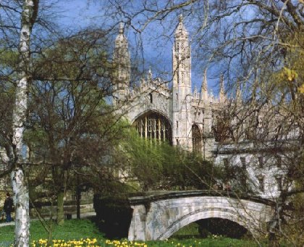

Downgrading (2)
Text hidden in least significant bits of image

Slide 17
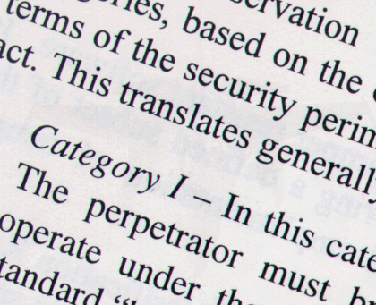

Downgrading (3)
Picture hidden in three least significant bits of text

Slide 18
Examples of MLS Systems
SCOMP – Honeywell variant of Multics, launched 1983. Four protection rings, minimal kernel, formally verified hardware and software. Became the XTS-300
Used in military mail guards
Motivated the ‘Orange Book’ – the Trusted Computer System Evaluation Criteria
First system rated A1 under Orange Book

Slide 19
Examples of MLS Systems (2)
Blacker – series of encryption devices designed to prevent leakage from “red” to “black”. Very hard to accommodate administrative traffic in MLS!
Compartmented Mode Workstations (CMWs) – used by analysts who read Top Secret intelligence material and produce briefings at Secret or below for troops, politicians … Mechanisms allow cut-and-paste from L → H, L → L and H → H but not H → L
The Australian failure

Slide 20
Examples of MLS Systems (3)
The NRL Pump was designed to copy data continuously up from Low to High with minimal covert channel leakage

Slide 21
Examples of MLS Systems (4)
LITS – RAF Logistics IT System – a project to control stores at 80 bases in 12 countries. Most stores ‘Restricted’, rest ‘Secret’, so two databases connected by a pump
Other application-level rules, e.g. ‘don’t put explosives and detonators in the same truck’
Software project disaster, 1989–99!
Eventual solution: almost all stuff at one level, handle nukes differently

Slide 22
Examples of MLS Systems (5)
DERA’s ‘Purple Penelope’ was an attempt to relax MLS to accountability for lower levels of stuff
Driver: people determined to use Office
Solution: wrapper around Windows that tracks current level using high watermark
Downgrading allowed, but system forces authentication and audit
Now called ‘Sybard Suite’

Slide 23
Multilevel Integrity
The Biba model – data may flow only down from high-integrity to low-integrity
Dual of BLP:
  Simple integrity property: subject may alter object only at same or lower level
  *-integrity property: subject that can observe X is allowed to alter objects dominated by X
So you have low watermark properties, etc
Example: medical equipment with two levels, “calibrate” and “operate”

Slide 24
Multilevel Integrity (2)
Big potential application – control systems
E.g. in future “smart grid”
  Safety: highest integrity level
  Control: next level
  Monitoring (SCADA): third level
  Enterprise apps (e.g. billing): fourth level
Complexity: prefer not to operate plant if SCADA system down (though you could)
So a worm attack on SCADA can close an asset

Slide 25
Multilevel Integrity (3)
LOMAC was an experimental Linux system with system files at High, network at Low
A program that read traffic was downgraded
Vista adopted this – marks objects Low, Medium, High or System, and has default policy of NoWriteUp
Critical stuff is System, most other stuff is Medium, IE is Low
Could in theory provide good protection – in practice, UAC trains people to override it!

